Slide 1
Technical Assessment
Cristhian Camilo Jaramillo Ramos

Slide 2
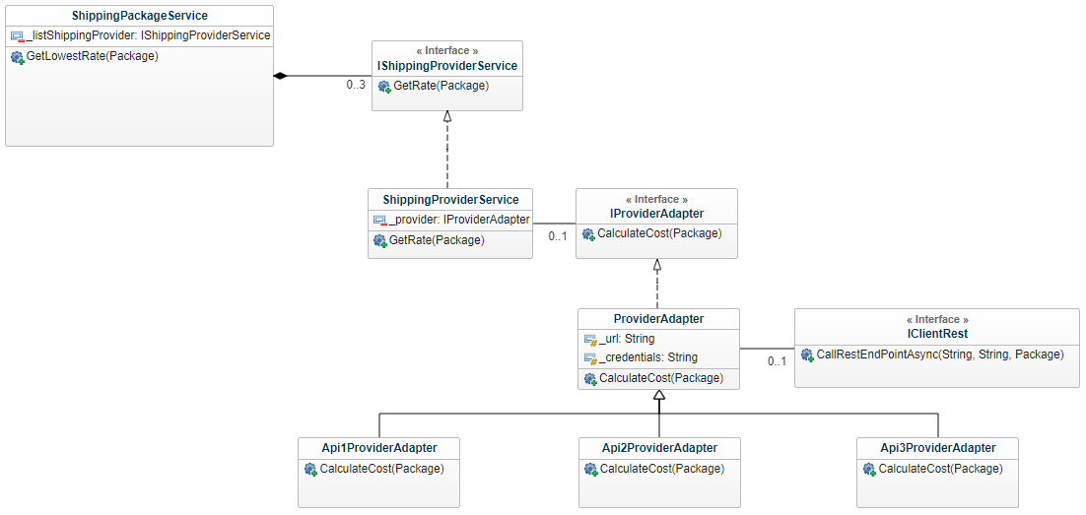
Class Diagram

Slide 3
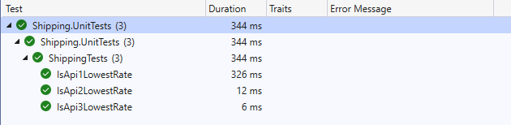
TEST CASES

Slide 4
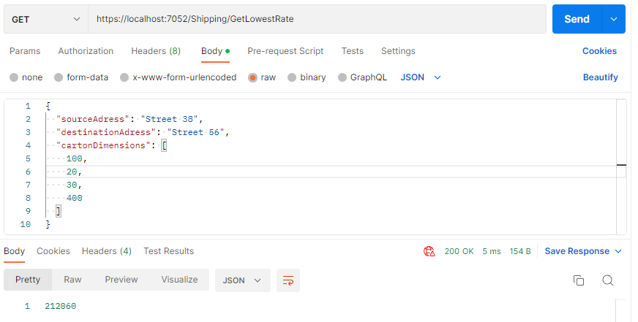
POSTMAN TESTING

Slide 5
Architecture of solution
SOLID Principles
Clean Architecture
DTO Pattern
Bridge Pattern
Adapter Pattern
TPL (Task Parallel Library)

Slide 6
Packages
Moq
Nunit
Xml.Serialization
AutoMapper
Threading.Tasks

